Slide 1
AI & BIG DATA PROJECT
Members
Thibaud CADET
Moruf BAMIGBOYE
Hon Ching YEUNG
Sébastien PALMAS
Dikky KURNIAWAN
Maxwell DJOUMESSI

Slide 2
Aim of the project
01
02
TABLE OF CONTENTS
04
03
05
06
Why detect hate speech
Data preparation
Data source and exploration
Model building and selection
Operation

Slide 3
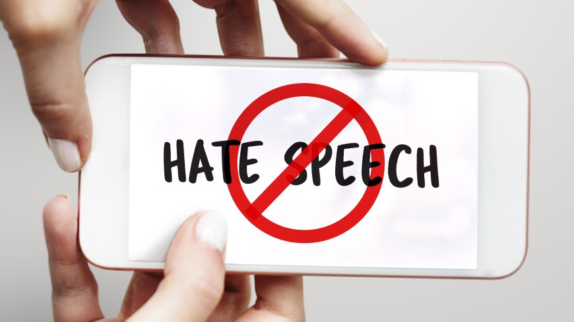
AIM OF THE PROJECT
Develop machine learning techniques for hate speech detection
in twitter data stream.
Hate speech is understood as any kind of communication in speech, writing or behaviour, that attacks or uses pejorative or discriminatory language with reference to a person or a group on the basis of who they are, in other words, based on their religion, ethnicity, nationality, race, colour, descent, gender or other identity factor.

Slide 4
WHY DETECT HATE SPEECH
Why Twitter?
Twitter is one of the most common social media and text-based social media, hence twitter is prone to hate speech content. In this project, we use tweets to analyze and predict whether they are hate speech, offensive language, or neither of them.
Hate speech is an important problem that is seriously affecting the society and usefulness of online social communities.
Social media and online platform continues to grow, so does the spread of hate speech
Hate speech is strongly associated with actual hate crime. To avoid such crime, we have to detect them before it happens.

Slide 5
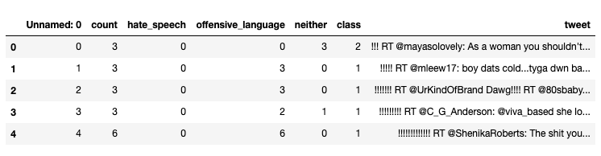
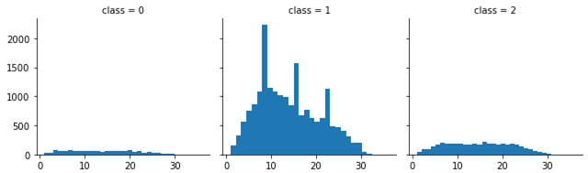
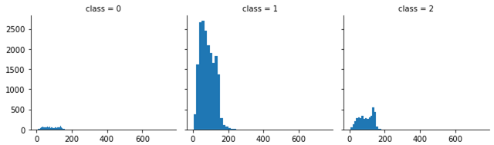
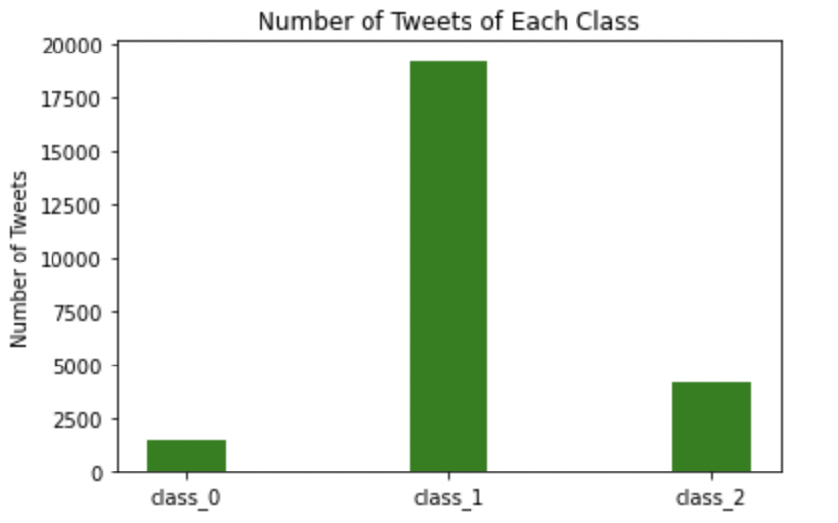
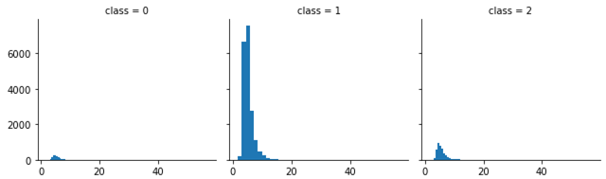
DATA SOURCE & EXPLORATION
DATASET
NUMBER OF WORDS
NUMBER OF CHARACTERS
NUMBER OF TWEETS OF EACH CLASS
AVERAGE WORD LENGTH
25k row (tweets)
Pre labeled with 3 categories: hate speech (class_0), offensive language (class_1), and neither (class_2)

Slide 6
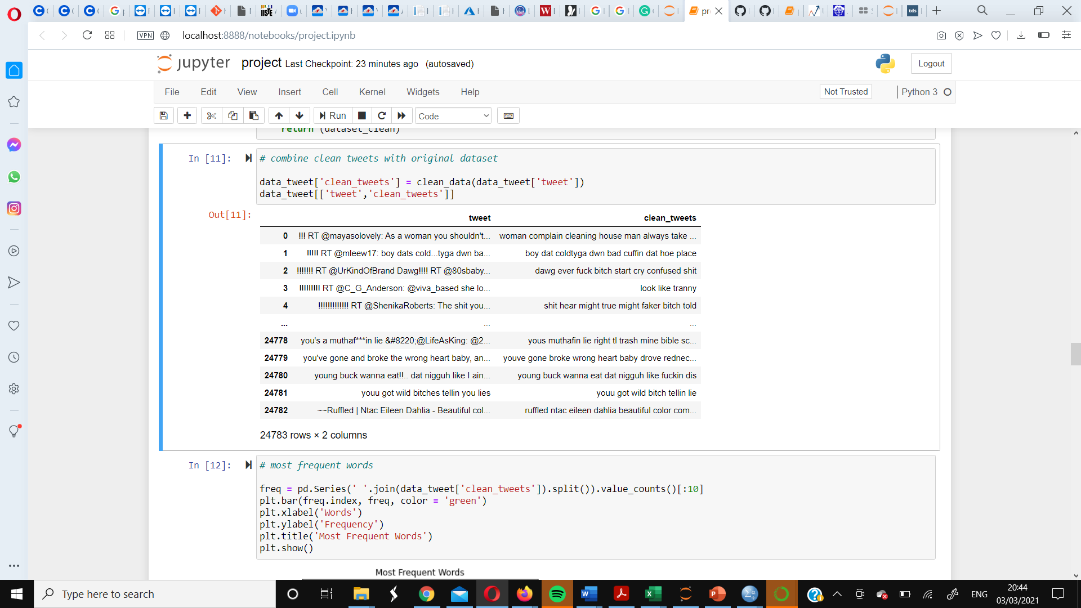

DATA PREPARATION
Preprocess tweets: clean data and make it suitable for modelling
make all words to lowercase
remove redundant space
remove
user names
remove all punctuations
call stop word list
self-define a stopword list
remove stopwords
remove
web address
remove numbers and words starting with numbers
lemmatization
Notes:
To prepare the tweets for our processing by our ML models, we did the some text cleaning like converting all words to lower case , removing extra spaces, usernames, url, punctuations and lemmatization of words used in our tweets

Slide 7
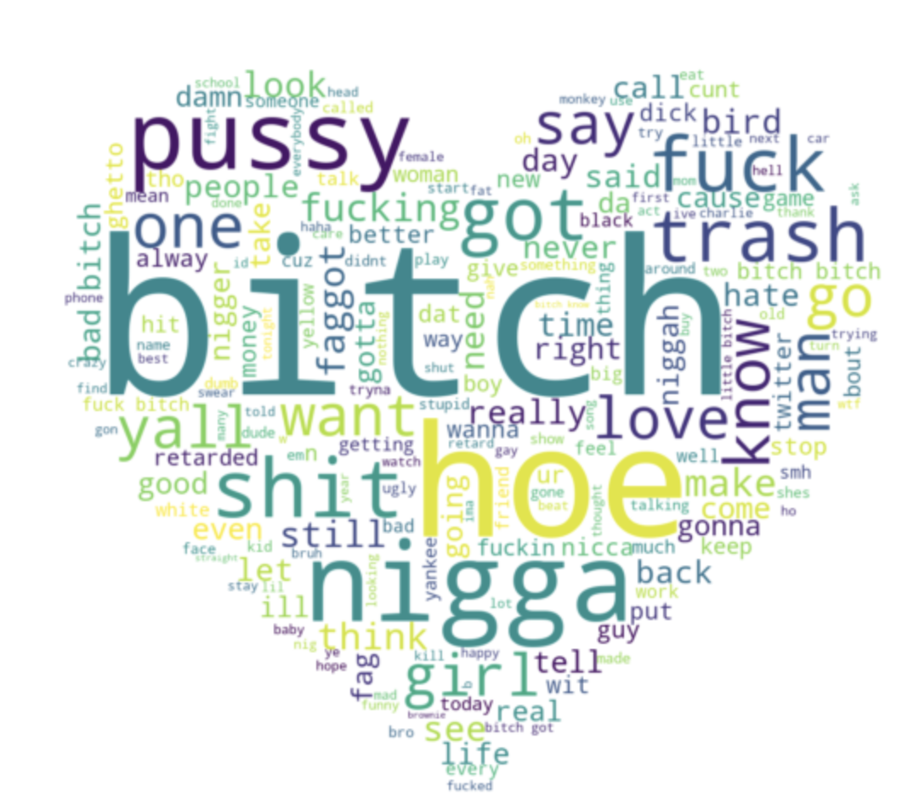
SENTIMENT ANALYSIS
MOST FREQUENT WORDS
OVERALL SENTIMENT
The overall sentiment of all tweets is: -0.06493506493506492
1: positive
-1: negative
Word cloud shows most frequent words in tweets and hints that some words are important in determining if a tweet is hate speech or not
Notes:
We explored our cleaned tweets to identify the most frequency

Slide 8
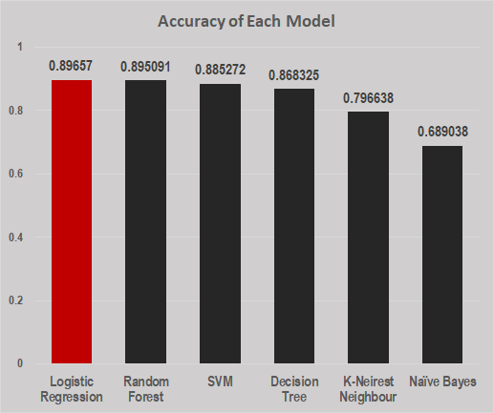
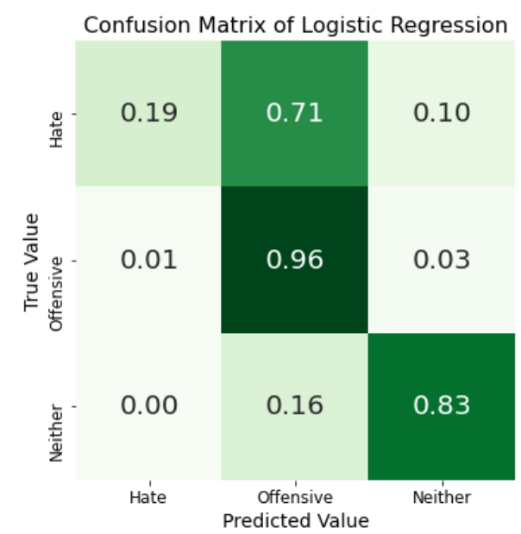
MODEL BUILDING & SELECTION
KNN
LOGISTIC REGRESSION
DECISION TREE
SVM
RANDOM FOREST
NAIVE
BAYES
FEATURES GENERATION
MODEL SELECTION
10k features generated by fitting a [1, 4] ngram tfidf vectoriser that converts words to statistical numbers.
DATA SPLIT:
LOGISTIC
REGRESSION
Training:
70%
Test:
30%
MODEL TRAINED
Notes:
10k features generated from preprocessed tweets using a [1, 4] ngram tfidf vectoriser that converts words into statistical numbers that reflect how important a word is to a document in a collection or corpus.
In order to effectively evaluate our model we splitted out data into a70/30 for training and test respectively.
We trained and evaluated six models with our dataset and selected the best one for our multi class problem using an accuracy metrics

Slide 9
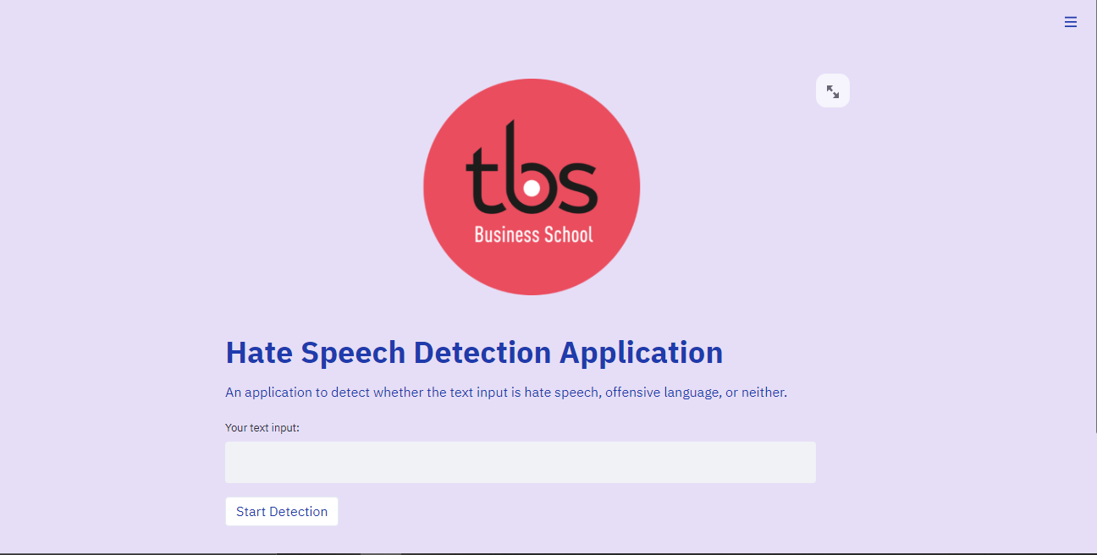
OPERATIONALISE
APPLICATION
Hate speech detection application with streamlit
An open-source app framework

Slide 10


THANKS FOR YOUR ATTENTION
any questions?

